Slide 1
EviWare
Inspection and Evidence control system

Slide 2
Company Profile
Promact is an excellence driven company with a passion for technology where people love what they do. We focus on delivering values, creating impact & producing exciting experiences.
A blend of a good idea, creativity, simplicity, robust technical implementation and an exceptional team is nothing less than an innovation. We pride ourselves for that.
Fun workplace, technology leader, target excellence - these three pillars of our vision are the key foundation of Promact. Our vision makes us what we are, an exciting workplace, a technologically leading company & an exceptional service provider. We love start-ups! Our team includes co-founders from other start-ups. We love seeing awesome things happening around us. We strive and encourage the culture of start-ups. We have helped start-ups reach from 100 users to million users. We not only provide development services but also share our personal start-up experience which can help you streamline and grow with your start-up.

Slide 3
Project Profile
Project Name : Eviware (Inspection and Evidence control system)
Type of Application : Website
Project Description :
Inspection and evidence system specializing in management and controlling the proper flow of documents and task from point of origin to point of distribution
Main purpose of this system is to eliminate the paper work to handle all documents. Management of proper service flow with less time and money by automating manual processes with the help of different technologies.
The proposed system will feature different modules that ensures the proper flow of documents and related task to all those who are concerned with a job.
A system that would be able to manage users with authentication, their documents, verification of team members, forms for task, flow of entities from source to destination with proper validation, assets that are required to perform different task etc.

Slide 4
Introduction to tools
Team Size: 2
Front End: Angular 6
Back End: ASP.NET Core
Database: PostgreSQL
Tools used: Visual Studio 2017, Visual Studio Code

Slide 5
System Study

Slide 6
Existing System
The existing system is comprised of maintaining physical documentation & manual transfer of those documents without proper sharing mechanism in order to achieve evidence control & inspection service.
It is possible to have multiple users or task tracker in a particular job. To maintain the flow of entities, inspection, and evidence one has to manage it manually by maintaining physical documentation of each and every process in existing system for evidence control and inspection management.
Most of the time it would be very difficult to do paperwork if tasks or documents are too large with respect to time or complexity.

Slide 7
Proposed System
This system is being built on a web platform that will manage personal documents and business-related financial documents on a single platform without having any manual paperwork.
It manages Supply chain management from source to destination with the proper flow of goods by providing quality assurance and quality control.
This centralized platform will use different machine learning techniques to verify the proper quality and quantity of goods. This makes it easy to follow product and process chain of supply by simply reviewing reports which answer who, what, where and when for every element you see.

Slide 8
Scope of the Proposed System
This system will allow users to use all the modules provided in it after success full login followed by registration.
After proper verification of details such as username/email and password, functionality would be accessible to the user.
As per the requirement user can create forms for job and assets, view and update profile, upload and download data sheets, create Jobs with required fields. view job with different format, add team members who are responsible to get the task done, generate report, add attachments (images, files, audio, video) etc.

Slide 9
Aim and Objective of the Proposed System
Inspection and evidence system specializing in management and controlling the proper flow of documents and task from point of origin to point of distribution
Main purpose of this system is to eliminate the paper work to handle all documents. Management of proper service flow with less time and money by automating manual processes with the help of different technologies.
The proposed system will feature different modules that ensures the proper flow of documents and related task to all those who are concerned with a job.
A system that would be able to manage users with authentication, their documents, verification of team members, forms for task, flow of entities from source to destination with proper validation, assets that are required to perform different task etc.

Slide 10
Feasibility Study
Operational Feasibility
The System efficiently Operates and Reduce Manual Computation and Time of Processing, Reducing Cost of Paper works and Human Errors.
Technical Feasibility
The System can be implemented using Computer Software and Hardware.
Economic Feasibility
The System implementation is quite economical if either for a single individual as well as for large enterprises.

Slide 11
System Analysis

Slide 12
Requirement Specification
Hardware Requirement:
PC/Laptop/Smartphone with internet access.
Memory:2GB
Processor: Intel x86/ AMD/ ARM based processor @ 1GHz
RAM: Minimum 1 GB
System type: 32/64-bit
Software Requirement:
Any type of operating system that supports web browsing.
Web browser for PC/ Laptop.
Android/ iOS for native mobile application support.

Slide 13
Use Case Diagram

Slide 14
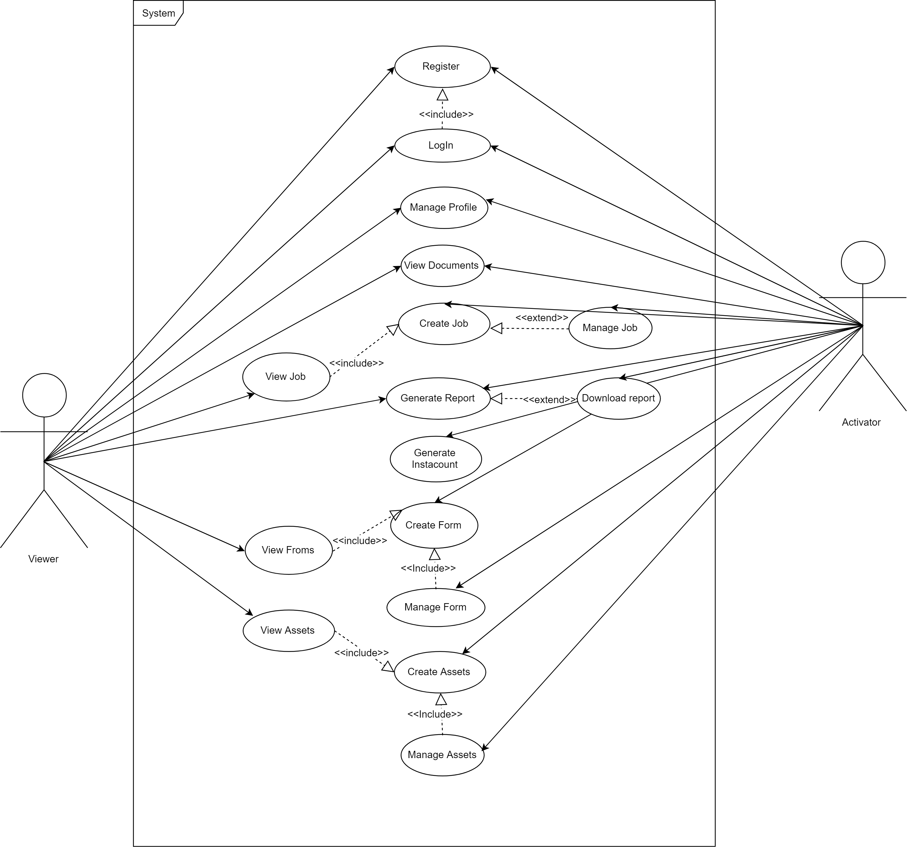

Slide 15
Flow Chart

Slide 16
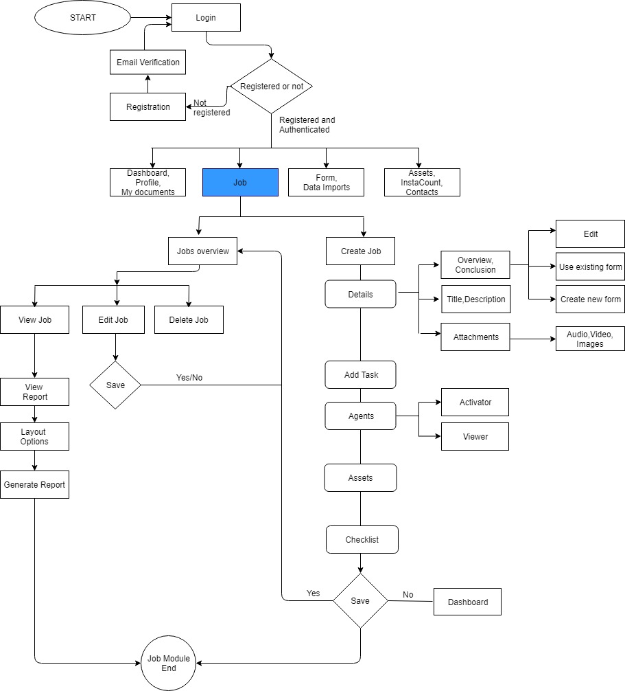

Slide 17
Job Module Flow

Slide 18
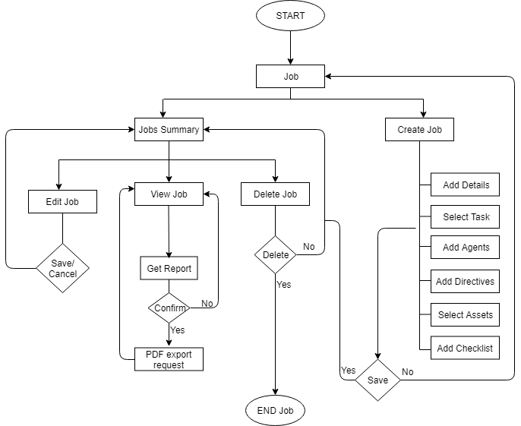

Slide 19
Activity Diagram

Slide 20
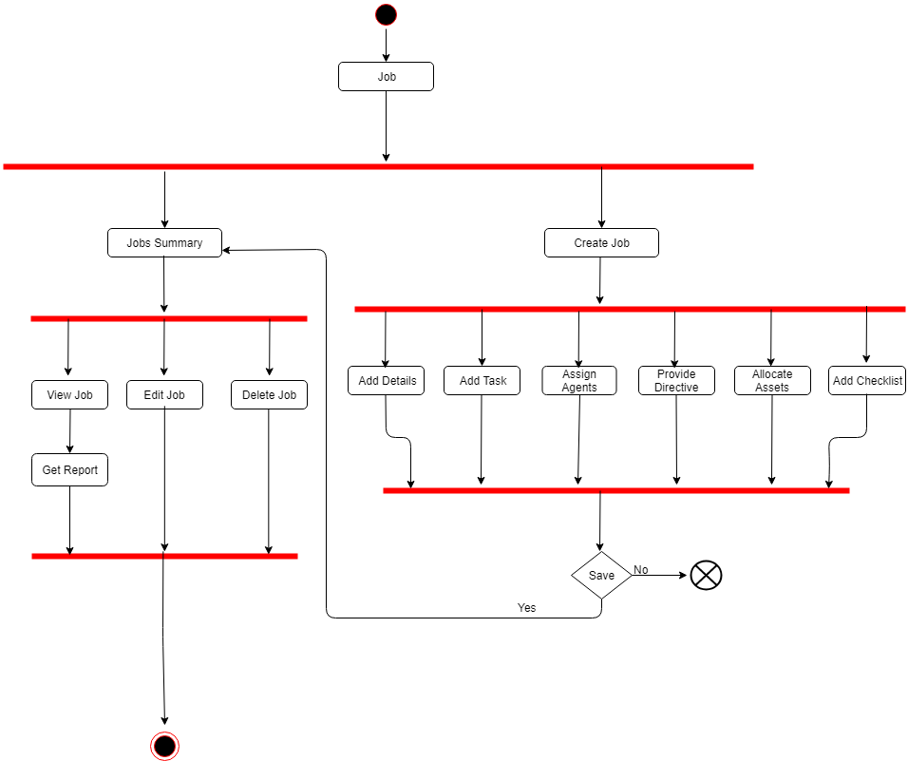

Slide 21
Class Diagram

Slide 22
System Design

Slide 23
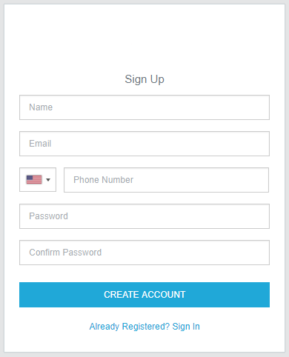
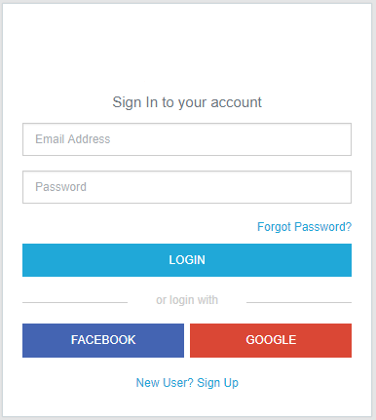

Slide 24
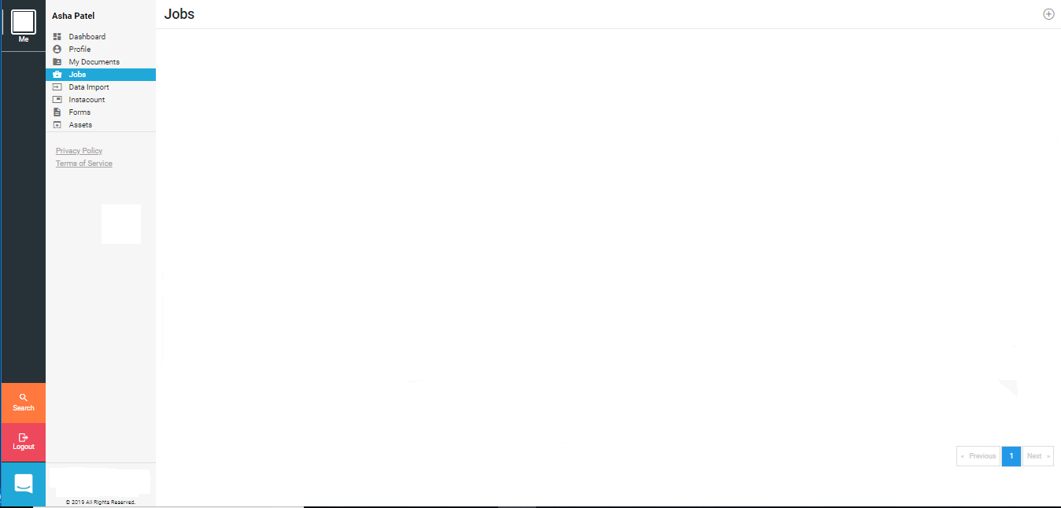

Slide 25
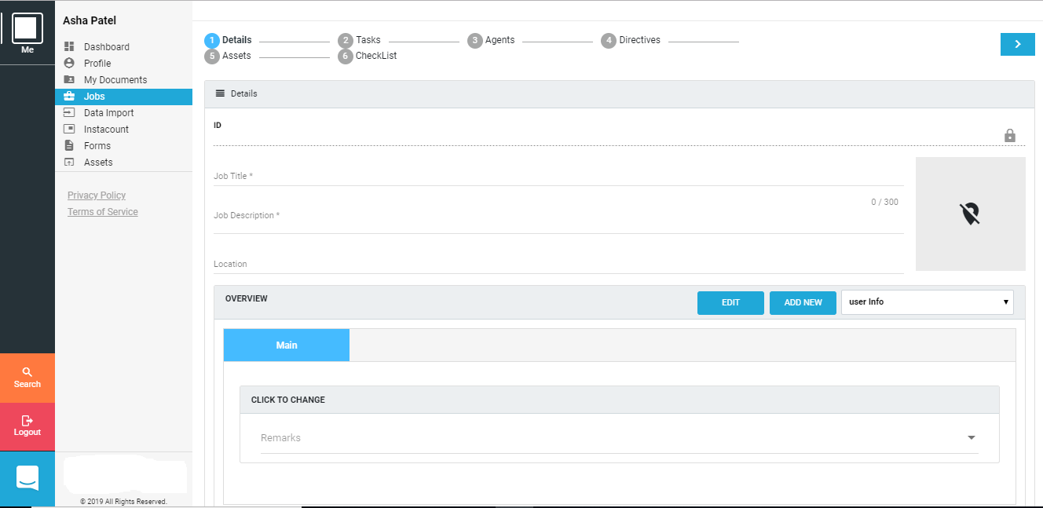

Slide 26
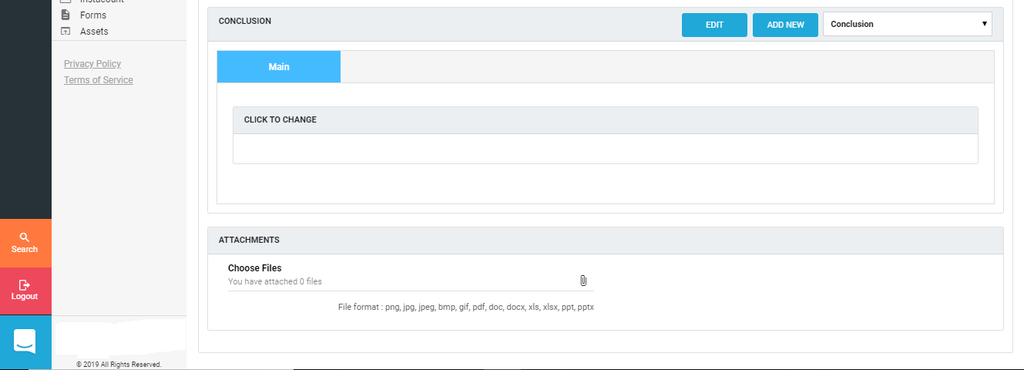

Slide 27
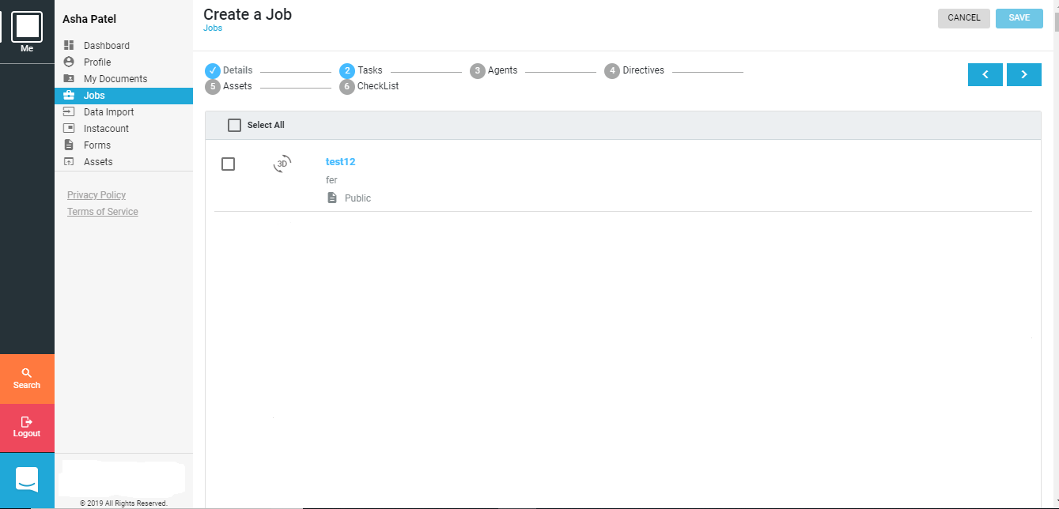

Slide 28
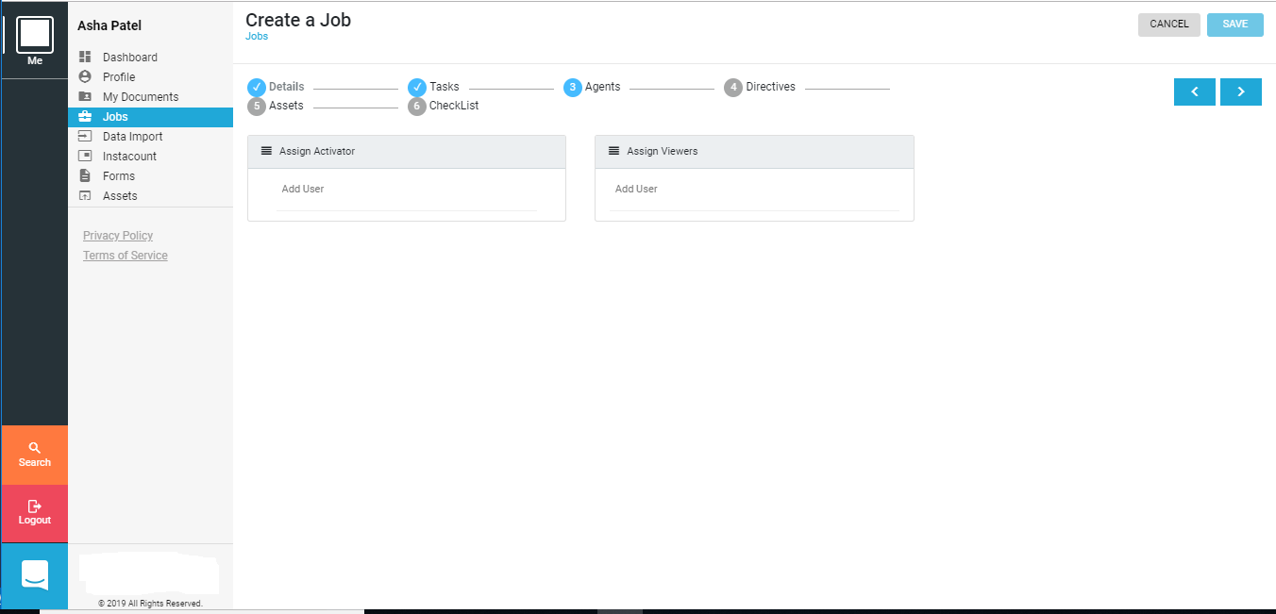

Slide 29
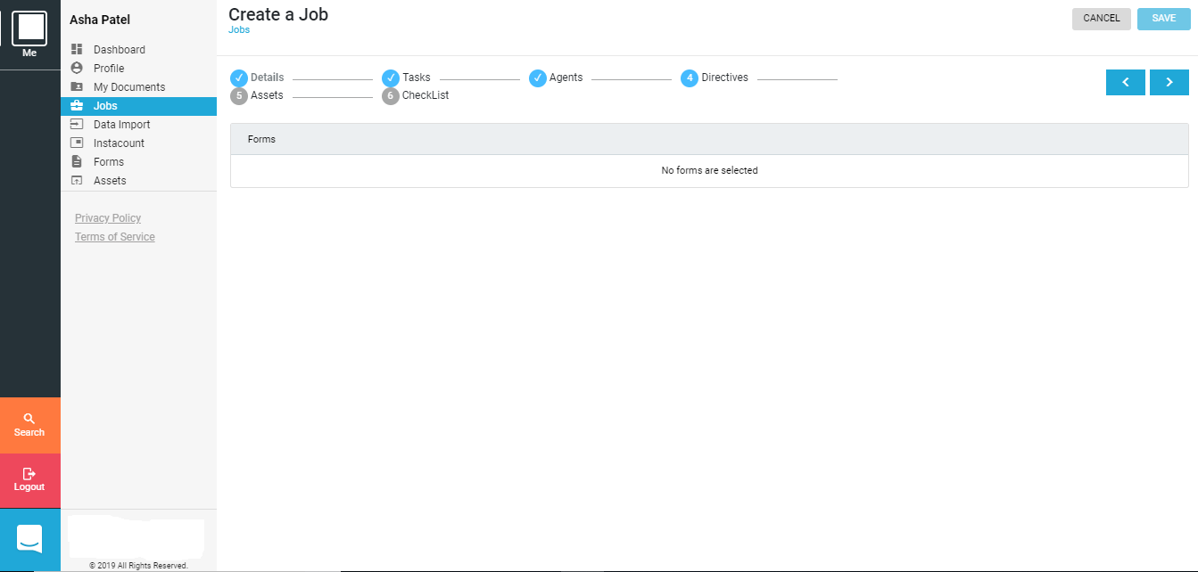

Slide 30
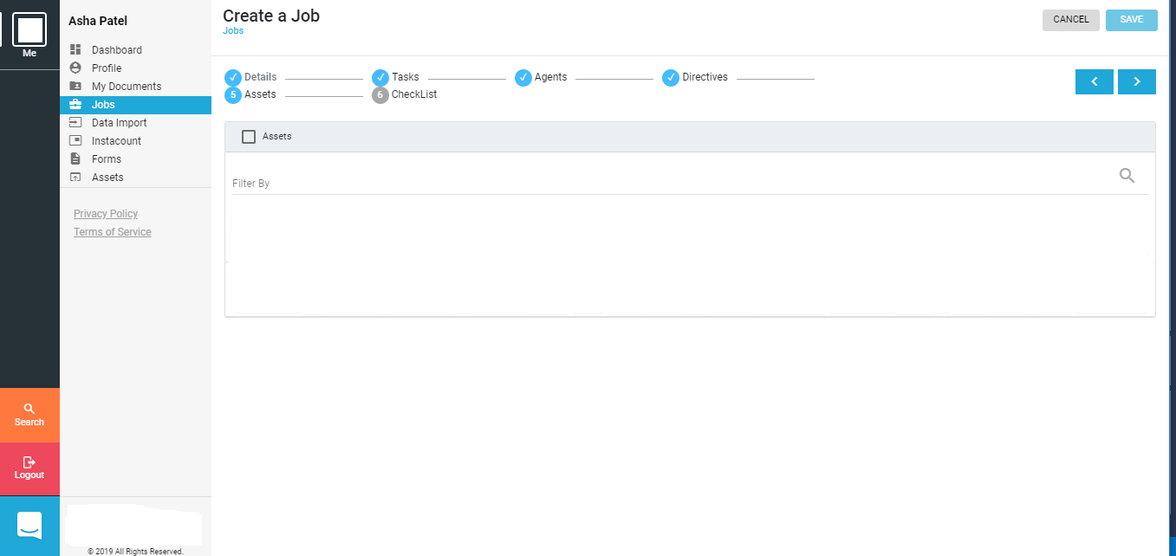

Slide 31
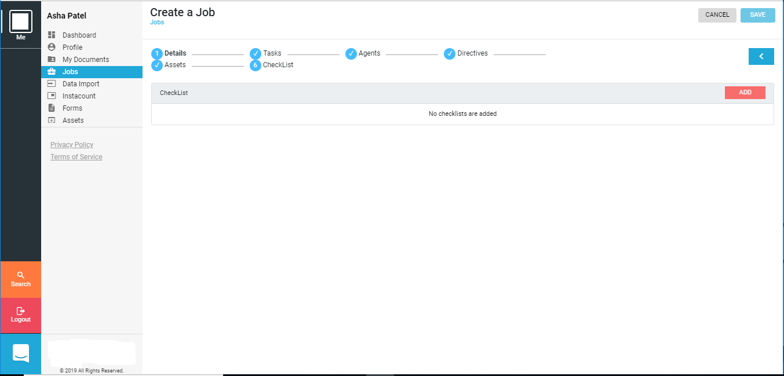

Slide 32
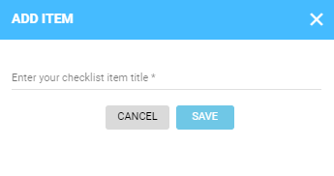
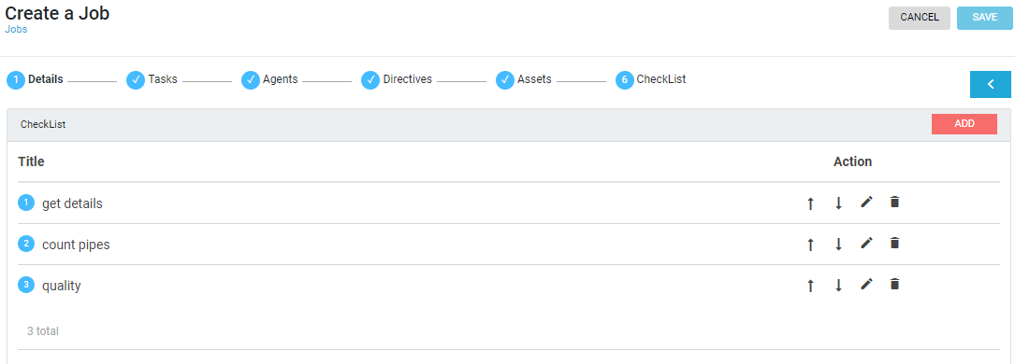

Slide 33
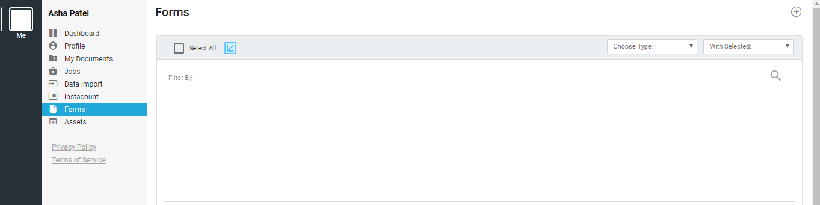
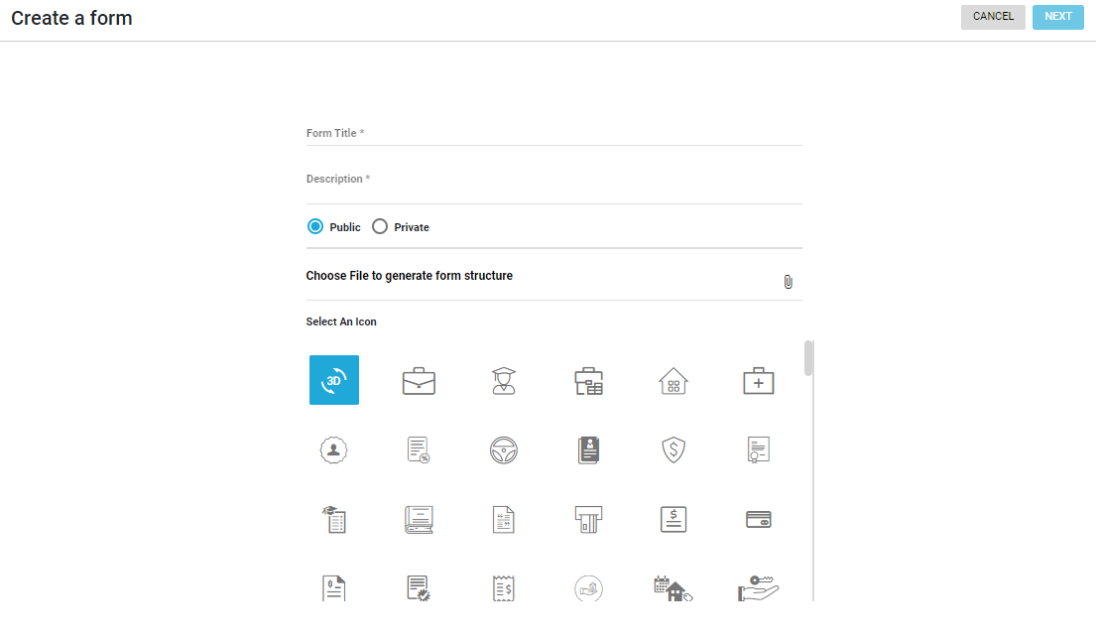
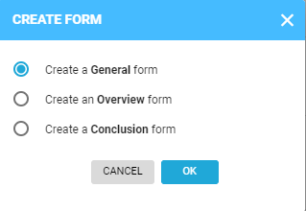

Slide 34
Testing Strategies

Slide 35
Future Enhancement
In the Future a new functionality called Instacount will be added to determine number of products using machine learning techniques.
A filter mechanism will be implemented to filter jobs as per certain parameters.
Directives module will be implemented so that users will be able to provide directives to a job.
Job reports functionality will be added so that users can generate Job reports with different options.

Slide 36
Bibliography/References

